Slide 1

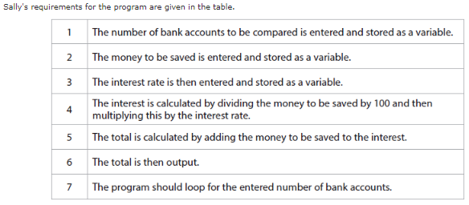
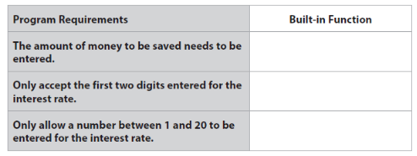
Bronze 1
Exam Questions
input
truncation
range

Slide 2
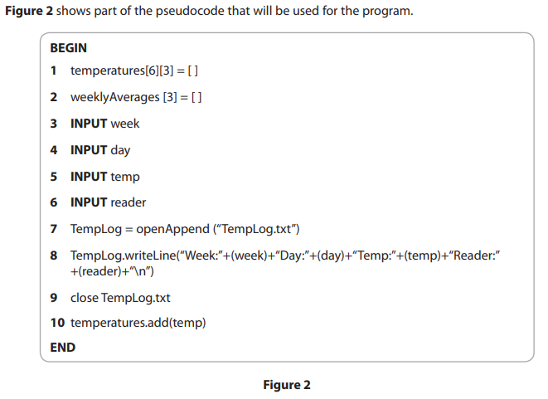
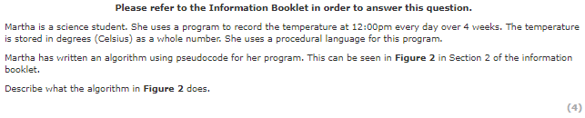
Bronze 2
Exam Questions
Type below[4 marks]
The algorithm declares 2 arrays (temperatures and weeklyaverage) . Then takes input for the day, in week and day - takes the temperature in degrees Celsius as well as the name of the reader then opens a file, appends it to a file outputs it in a concatenated string, then closes the file.

Slide 3
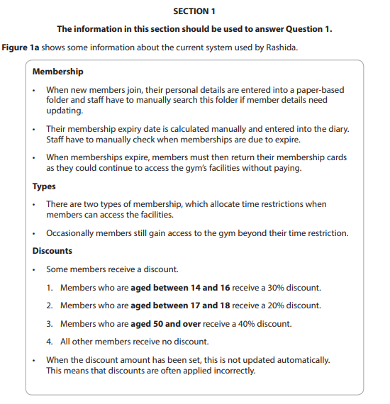
Silver 1
Exam Questions

Slide 4
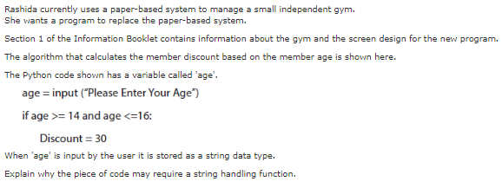
Silver 1
Exam Questions
Type below[3 marks]
The age needs to be converted into an integer. This is because it is a number and cannot be used in ‘greater than’ or ‘less than’ functions if it is a string.

Slide 5
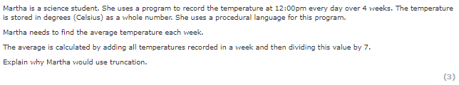
Silver 2
Exam Questions
Type below[3 marks]

Slide 6
Gold 1
Exam Questions

